Slide 1
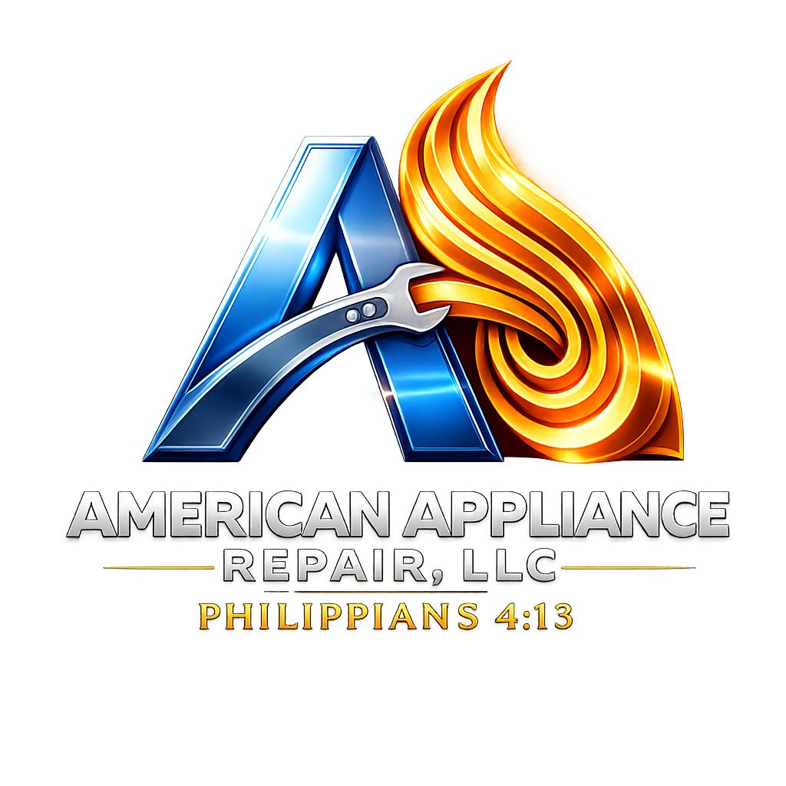
AMERICAN APPLIANCE REPAIR LLC
The Company You Can Trust
Dryer Maintenance
Protecting Homes, Saving Money & Preventing Fires
Presented by Rafael Cordero, President
Veteran-Owned • Christian-Owned • Serving Corpus Christi & South Texas

Slide 2





Why Dryer Maintenance Matters
Thousands of home fires each year are linked to dryers — and a lack of maintenance is the leading cause.
WHEN LINT BUILDS UP
REGULAR MAINTENANCE DELIVERS
1
Airflow is restricted
Faster drying times
2
Heat cannot escape
Lower electricity usage
3
Components overheat
Longer appliance lifespan
4
Energy bills increase
Fewer unexpected breakdowns
Increased safety for your family
5
Fire risk rises dramatically
KEY MESSAGE
A simple maintenance service today can prevent thousands of dollars in repairs tomorrow — and may even save your home.

Slide 3



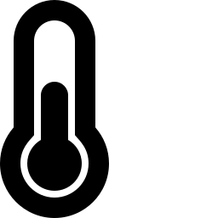
Common Dryer Hazards
The most common problems we find during service calls:
Lint accumulation inside the cabinet
Clogged dryer vents
Burned heating elements
Melted electrical wiring
Worn drum rollers and belts
Damaged blower wheels
Overheated thermostats
Loose electrical connections
Most homeowners only clean the lint filter after each load — but hidden buildup inside the machine and exhaust vent is where many fires begin.

Slide 4

Warning Signs Your Dryer Needs Service
If you notice any of these symptoms, it's time for a professional inspection:
Clothes take longer than one cycle to dry
The dryer feels unusually hot
You notice a burning smell
Excessive lint collects around the dryer
The dryer shuts off unexpectedly
The laundry room becomes hot and humid
Your electric bill suddenly increases
These warning signs should never be ignored.

Slide 5
Protect Your Investment
Home Appliance Care Membership
MEMBER BENEFITS
STARTING AT
One annual preventive maintenance visit per covered appliance
$19.95
25% off eligible repair labor
per month
10% off eligible replacement parts
COVERAGE
Priority scheduling
1 Appliance — $19.95/mo
Each Additional — +$5.95/mo
Complete appliance safety inspection
Digital service history & maintenance recommendations
We inspect every visit:
Heating system • Airflow • Vent restrictions • Thermal fuse • Thermostats • Belt • Rollers • Idler pulley • Blower wheel • Wiring • Internal lint • Overall safety
Exclusive member promotions
Preventive maintenance costs far less than replacing an appliance — or repairing damage caused by a dryer fire.

Slide 6





Building More Than an Appliance Company
American Appliance Repair is part of a larger vision — American Alliance Group.
American Appliance Repair
American Appliance Parts
American Appliance 4U
American Climate Solutions
American Power
American Technical Academy
American Vision (Nonprofit)
OUR FUTURE VISION
Protecting homes • Reliable appliance sales & service • Professional parts supply • Training the next generation of technicians • Expanding into energy & climate solutions • Investing in our community
Our mission isn't simply to repair appliances — it's to build opportunities, strengthen families, and serve our community with integrity and excellence.

Slide 7
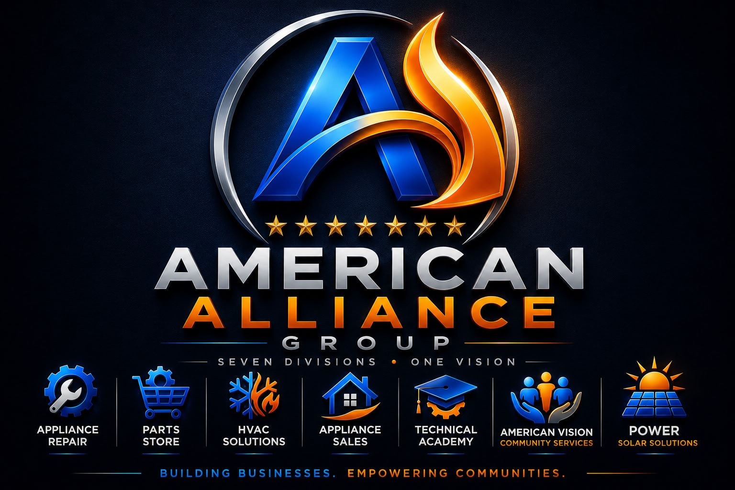

Slide 8
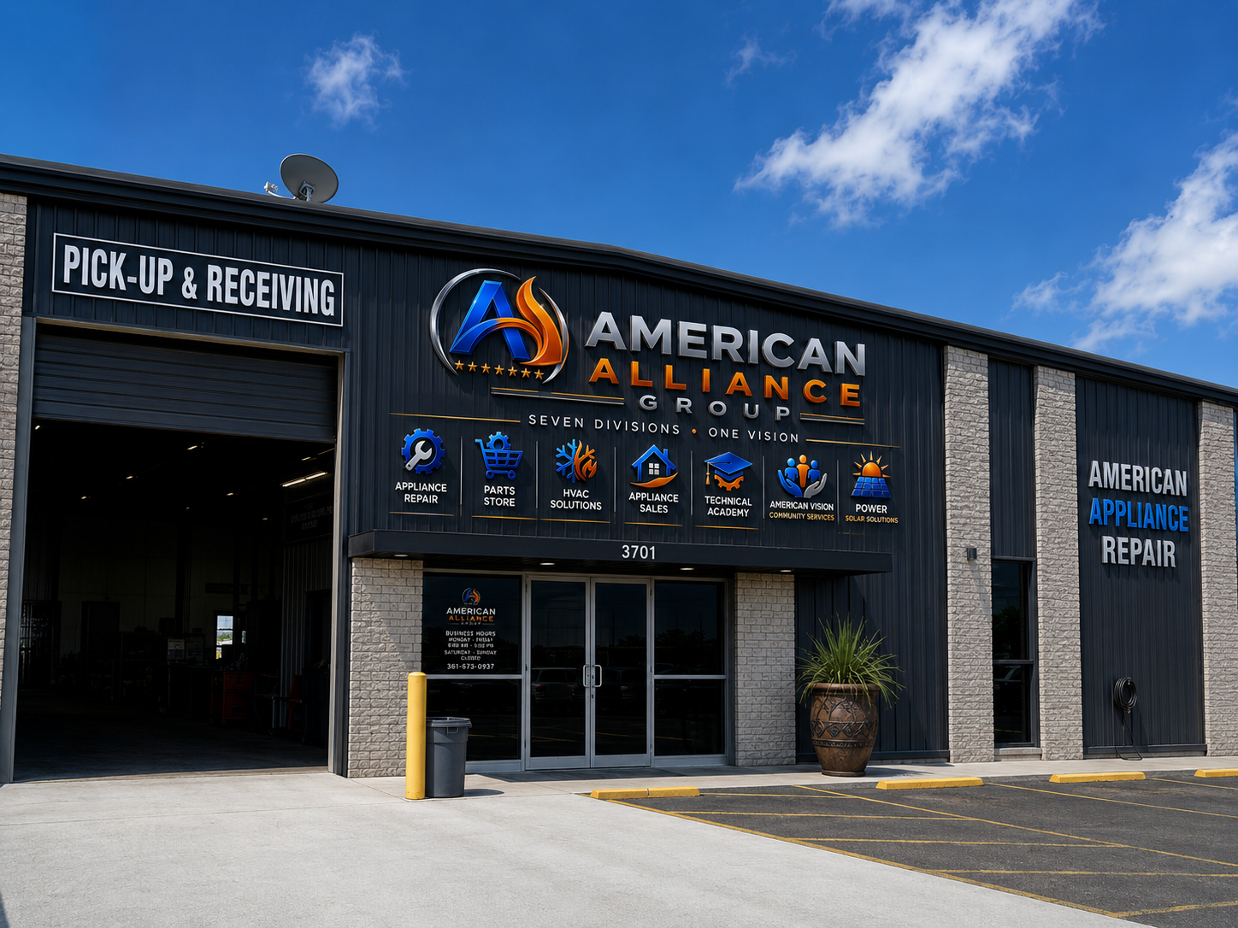

Slide 9



Thank You
Maintaining your dryer isn't just about keeping your clothes dry — it's about protecting your home, saving money, and keeping your family safe.
Questions about dryer maintenance, appliance safety, or our preventive maintenance membership? I'd be happy to answer them.
AMERICAN APPLIANCE REPAIR LLC
The Company You Can Trust
3701 Apollo Rd, Corpus Christi, TX 78413
Sales & Parts: (361) 400-9513
Service: (361) 673-0937

